Slide 1
Automated Recruitment Pipeline
Infosys Spring Board Internship
Kasa Pavan

Slide 2
Objective
Resume Screening for selection of the candidate for taking interview
Taking the interview of the candidate using AI-generated questions or manual interview
Collecting Transcript of interview
Use AI models to take the decision of selection or rejection of candidate
Automating the mail to concerned persons (HR/Manager)

Slide 3
Workflow for creating a Recruitment Pipeline
Data Creation
EDA
Feature Engineering
Model Creation
Post-Model Analysis
BERT Embeddings
Best Model
Model Creation
Mailing result to HR/Manager
Prediction Pipeline

Slide 4
Data Creation
Collecting Data will be either costly or time-consuming
Create synthetic data using LLM models
Use different feature combinations, like job roles, decisions, reasons for selection or rejection, and metadata: years of experience, education, skills, interview difficulty.
Create prompt , pass it to LLM, and generate data
Used Together.ai
Synthetic Data : [‘Resume’ , ‘Job Description’ , ‘Transcript’ , ‘Decision’ , ‘Reason for Decision’]

Slide 5
Exploratory Data Analysis
Word Count Difference:
Statistically proven using a T-test that the number of words in transcripts varies significantly between selected and rejected candidates.
TF-IDF Similarity Analysis:
Selected candidates have a higher similarity between their transcripts and job descriptions compared to:
Resume & job description
Resume & transcript
No , Transcripts have > 80% similarity between them so no duplicates in the synthetic data

Slide 6
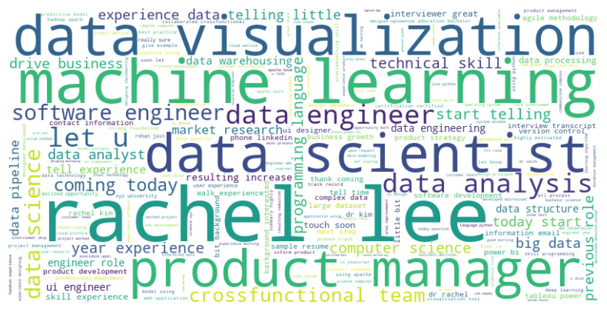
EDA
Word2Vec Similarity Patterns:
Using Word2Vec, selected candidates show higher similarity across:
Resume & Job Description
Job Description & Transcript
Transcript & Resume
Text Preprocessing:
Removed stopwords, punctuation, and contractions
Applied lemmatization and vectorization (TF-IDF & Word2Vec)
Word Cloud:

Slide 7
Model Training
Using external features, those are described using the resume, transcript and job description
Inputs :
Transcript sentiment , Resume Sentiment , Transcript vocabulary diversity , Transcript words , resume average word length , years of experience , education count , similarity, skill match count
Output :
Select / reject

Slide 8
Training Results
Using Tf-Idf Vectorization
Model | Accuracy | Precision | Recall | F1 Score
Logistic Regression | 0.67 | 0.63 | 0.70 | 0.67
XGBoost | 0.807 | 0.78 | 0.82 | 0.802
Navie Bayes | 0.73 | 0.76 | 0.64 | 0.69
Random forest | 0.80 | 0.79 | 0.79 | 0.79
Support Vector Classifier | 0.78 | 0.78 | 0.75 | 0.77
All metrics are with respect to test data

Slide 9
Training Results
Using BERT embeddings of resume , job description , and transcript only
Model | Testing Accuracy
Xgboost | 0.82
Artificial Neural Network | 0.89
Ensemble (Mean probability prediction) | 0.94
LSTM | 0.79
Ensemble (Mean probability prediction) | 0.92

Slide 10
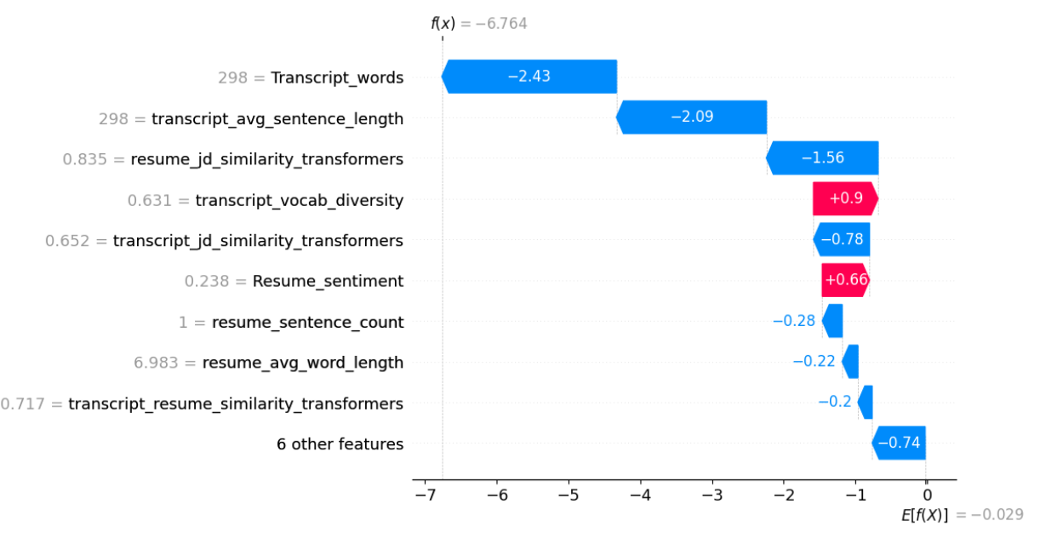
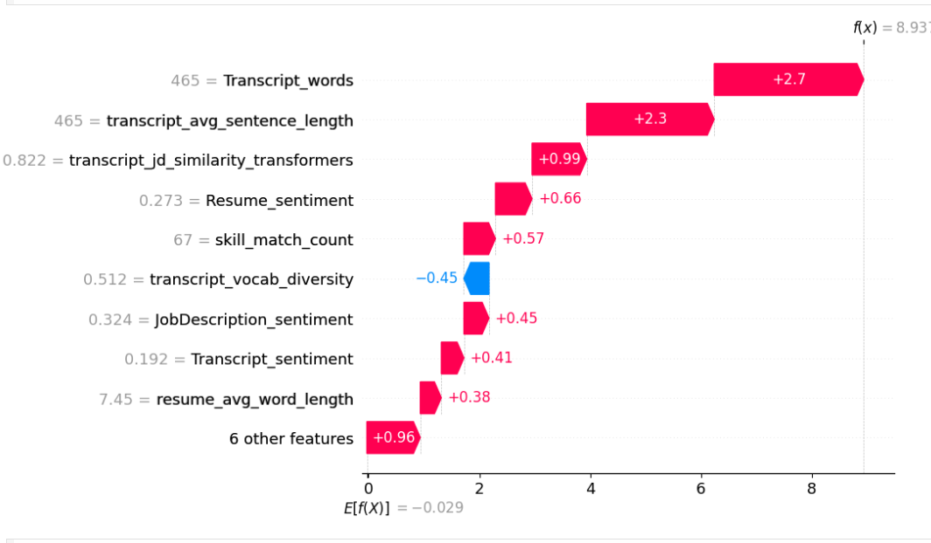
Post-model Analysis
SHAP Analysis for XGBoost Model with Tf-Idf Embeddings
Rejected Person
Selected Person

Slide 11
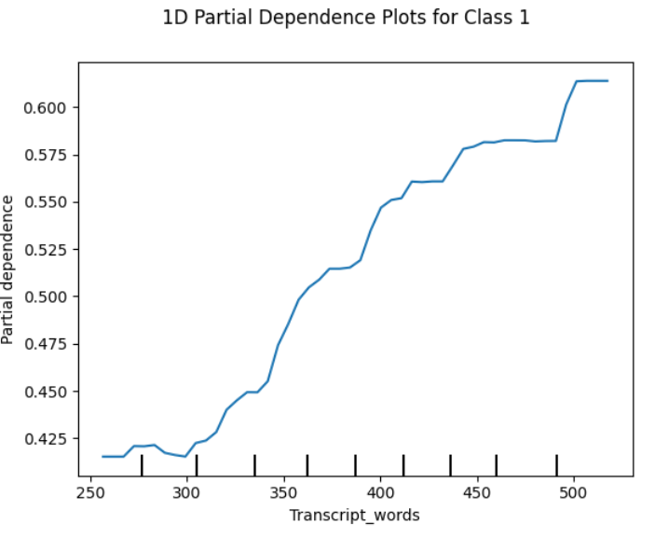
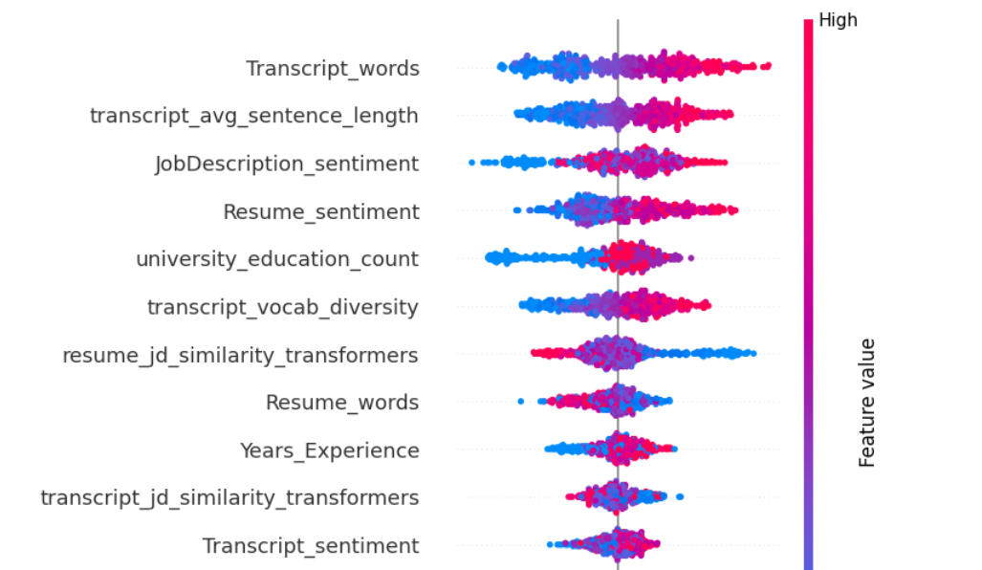
Beeswarm plot

Slide 12
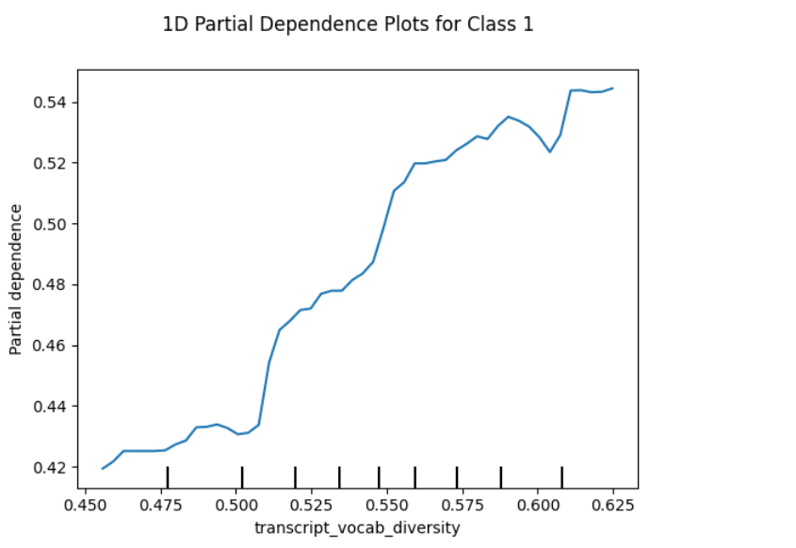
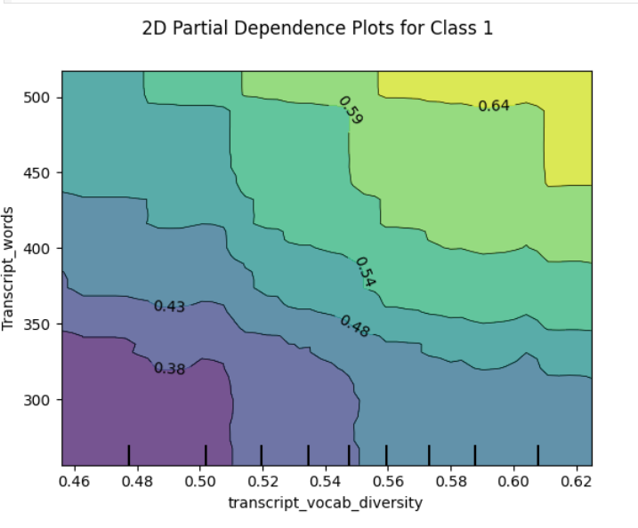

Slide 13
Resume Screening Technique
Using derived features and K-means Clustering
Derived Features
Normalization and approximate Weighting
K-Means Clustering
Highly Suitable
Moderately Suitable
Not Suitable

Slide 14
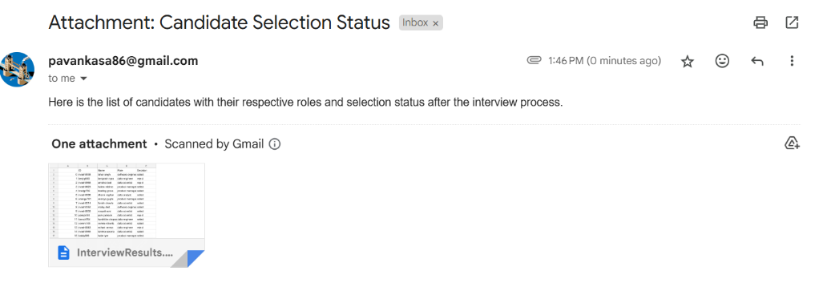
Prediction and Automation of Mail to HR/Manager
Collect a transcript of the interview, job description, and resume.
Pass it to the Preprocessing Class and get the preprocessed features
Pass the pre processed features to prediction pipeline (Best Models Selected)
Map the prediction with corresponding Class
Creates data of person name, person ID, mail, role, and decision.
Automates Mail using email and smtplib libraries in python for concerned managers/HR

Slide 15
Process Flow: From Start to Finish
Data Collection
No
Resume Screening
Reject
Yes
No
Reject
Technical Assesment
(Optional)
Yes
AI
Model
Select/Reject
Interview

Slide 16
Thank You

